Slide 1
Kafka Basics
POC Walkthrough

Slide 2
Agenda
Kafka and Related Services
Techstack of the POC Walkthrough
Kafka Use cases
Ksql Streaming
POC Flow

Slide 3
Techstack of the POC
Docker/Docker-compose
Postgres DB
Multi(3) Broker Kafka Cluster
ZooKeeper
Schema-registry
Kafdrop UI as Kafka Dashboard
ElasticSearch Service
Kibana UI for Indices visualize
Spring boot service for data generation of users and orders
KSql DB
KSql CLI
Kafka Connect & Connectors
a. FilePulse Source Connect
b. JDBC Source/Sink Connect c. ElasticSearch Sink Connect

Slide 4
Kafka Concepts
Broker
Cluster
Topic
Partition
Offset
Converters
Transform
Tasks
Consumer Group
Kafka Streams & KSQL DB: Fraud detection, Monitoring and alerting
Source/Sink Connector

Slide 5
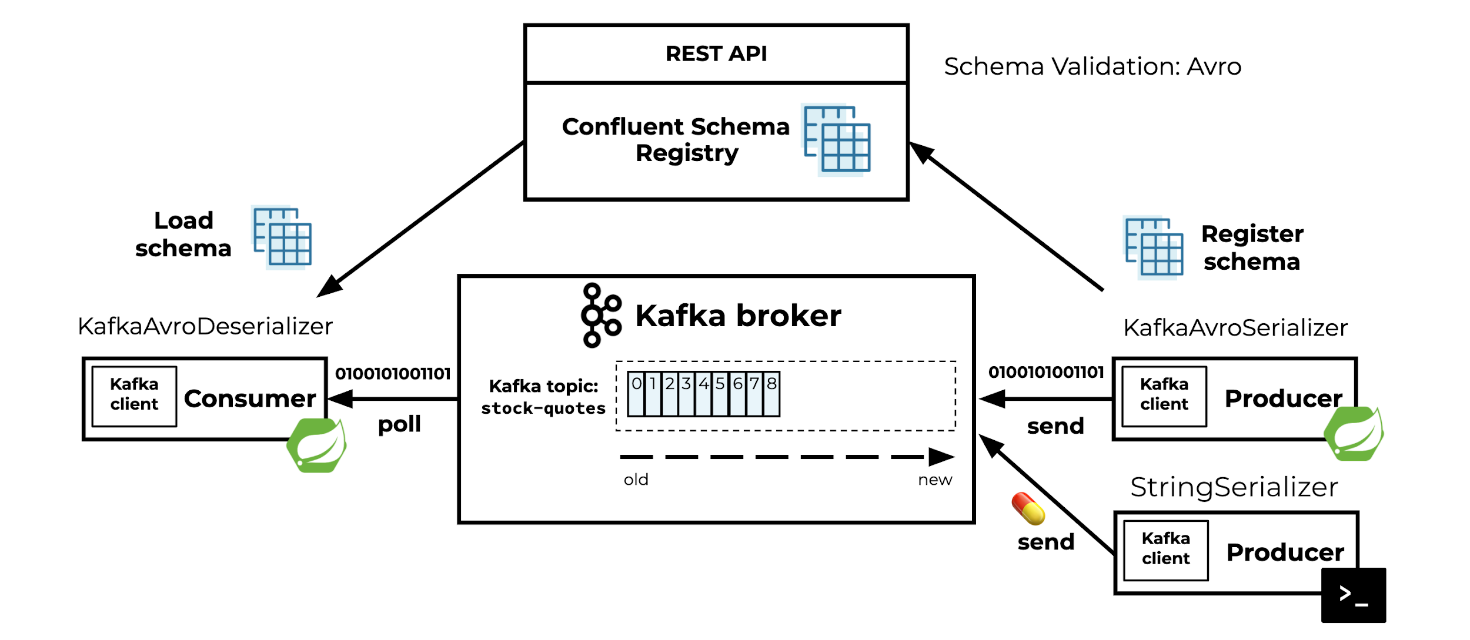
Kafka with Services as Producers/Consumers

Slide 6
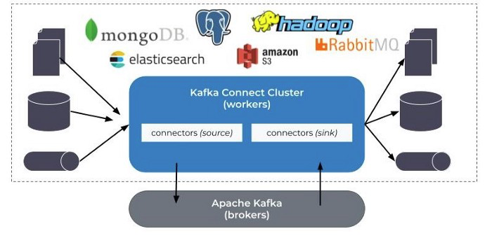
Kafka with Raw Sources
Kafka Connect is a framework for connecting Kafka with external systems such as databases, key-value stores, search indexes, and file systems, using so-called Connectors.

Slide 7
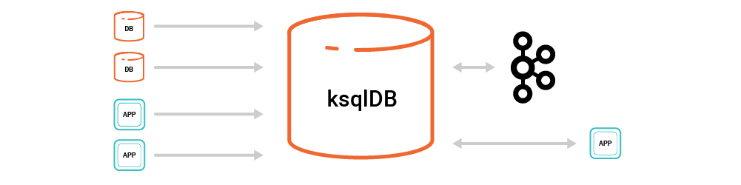
KSql DB of Kafka
KSqlDB is for stream processing and materializing asynchronously computed views. We can create continuously updating materialized views of data in Kafka and query those materializations in a variety of ways with SQL-based semantics.

Slide 8
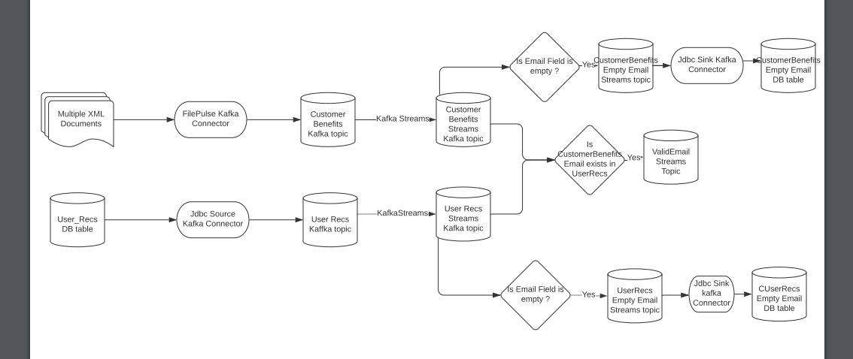
Current POC Flow Diagram
Data flow between connectors and raw sources, with Kafka as an integration layer

